Slide 1

Wire Frame Dallas Police Arrests SMU Data Science
Calvin Cusick, Malachai Cravens, Samuel Slomowitz

Slide 2
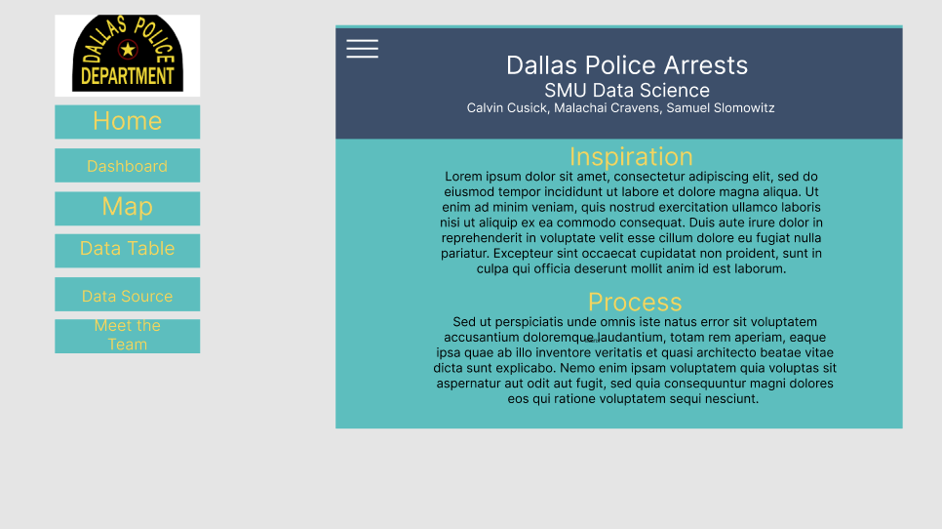

Slide 3
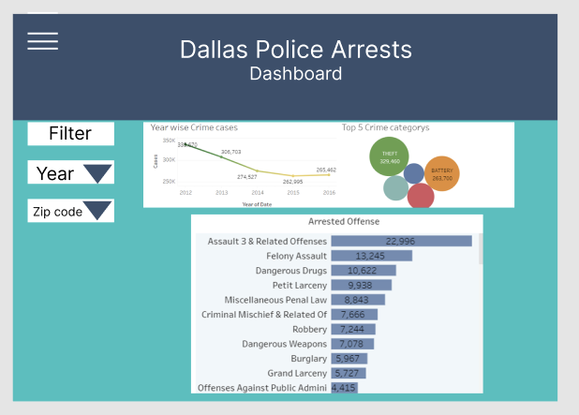

Slide 4
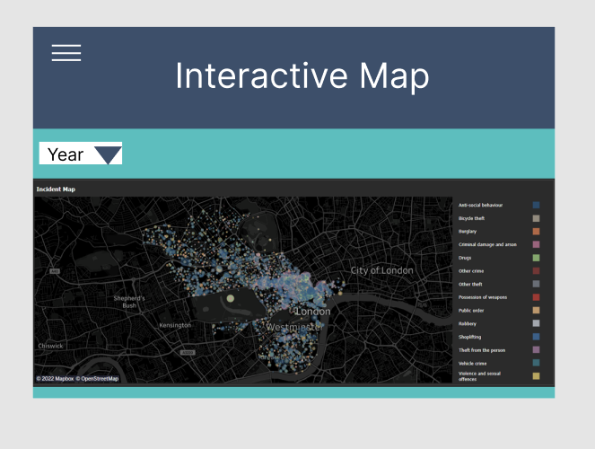

Slide 5
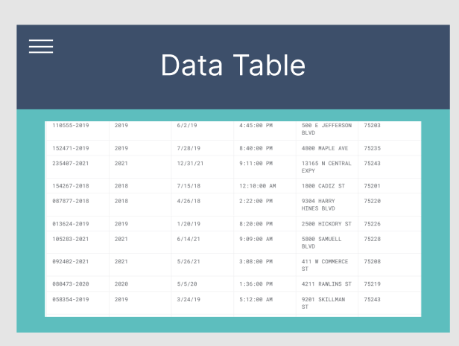

Slide 6


